Slide 1

Parallel Task
Scheduler
Comparative Performance Analysis of 5 Scheduling Algorithms
Implemented in C++ with OpenMP Parallelism
Made by :
Bipasha (102303388)
Suneet Singla (102303615)
Submitted to:
Dr. Saif Nalband
FCFS · Round Robin · MinMin · MaxMin · LoadAware
Notes:
‹#›

Slide 2
Project Overview
Objective · Technology · Experiment Design
Objective
Experiment Setup
Design and evaluate a parallel task scheduler using DAG-based workloads, comparing 5 scheduling algorithms across multiple configurations to identify the most efficient strategy.
Task Sizes: 50, 100, 200
Processors: 2, 4, 8
Total Configurations: 9
Approach
Key Idea
• Generate tasks with dependencies
• Apply different scheduling algorithms
• Execute in parallel using OpenMP
• Measure performance using 4 key metrics
Tasks are interdependent (DAG) and must be scheduled across multiple processors efficiently.
Build & Run
Tech Stack
make run → ./scheduler → results.csv → plot.py
C++ (OpenMP), Python (matplotlib), CSV pipeline
Notes:
‹#›

Slide 3
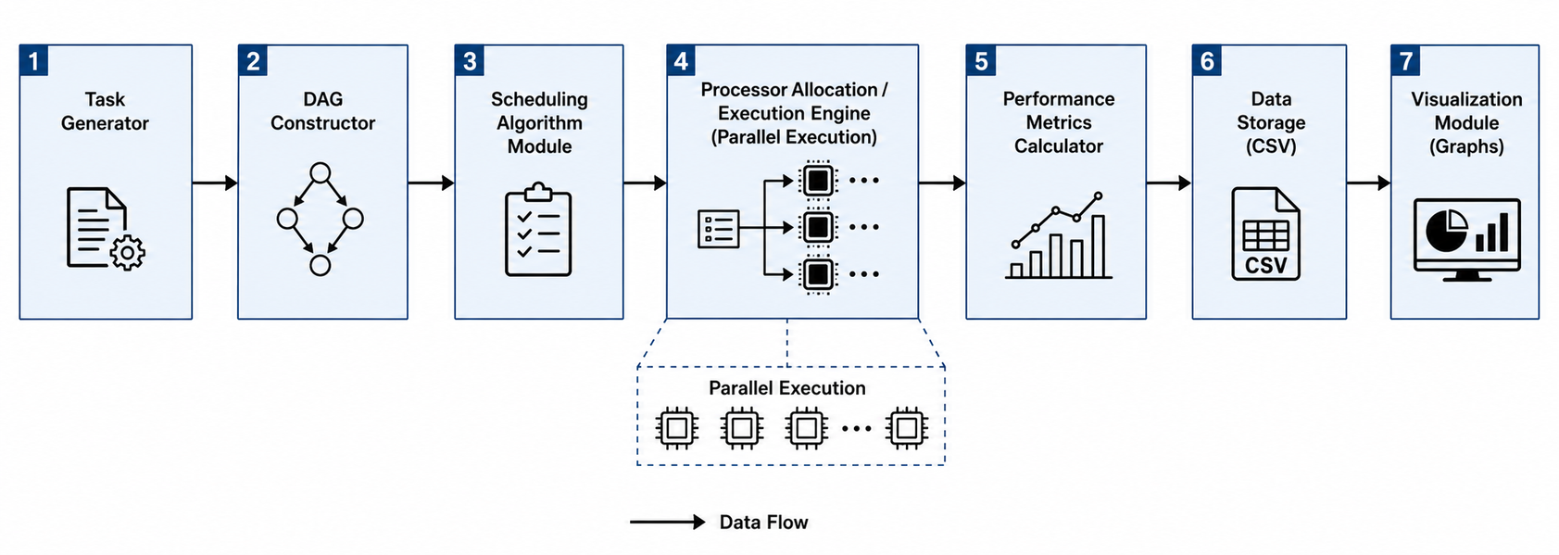
System Architecture and Key Concepts
Task Generator
DAG Constructor
Scheduler Module
Generates tasks with random execution times and dependencies
Builds dependency graph ensuring no cycles
Applies algorithm (FCFS, RR, Min-Min, Max-Min, Load-Aware)
Parallel Execution Engine
Metrics Calculator
Data Storage + Visualization
Executes tasks using OpenMP across processors
Computes makespan, utilization, speedup, imbalance
Stores results in CSV and generates graphs
Notes:
‹#›

Slide 4
Performance Metrics — Definitions & Formulas
Makespan
↓ Lower is better
Speedup
↑ Higher is better
max( finish_time[i] ) for all tasks i
Sequential_Time / Makespan
Total elapsed time from start until the last task completes. The primary throughput metric — lower is better.
How many times faster parallel execution is vs. running all tasks sequentially on one processor.
CPU Utilization
↑ Higher is better
Load Imbalance
↓ Lower is better
[ Σ (busy_time[p] / Makespan) ] / P × 100%
( max_busy − min_busy ) / avg_busy
Average fraction of time each processor does useful work. Low utilization means processors are sitting idle.
How unevenly work is distributed. 0 = perfect balance. High values mean some processors are overloaded while others idle.
Notes:
‹#›

Slide 5
Scheduling Algorithms
How each algorithm assigns tasks to processors
FCFS
Round Robin
MinMin
How: Tasks assigned in original ID order. Processor = task_index % P. No sorting.
How: A counter cycles 0 → P-1 → 0. Each task gets the next processor in rotation.
How: Ready tasks sorted ascending by execution_time. Shortest task scheduled first.
✅ Zero overhead, predictable
⚠ Ignores task length & load
✅ Even distribution by count
⚠ Ignores execution time differences
✅ Reduces idle wait times
⚠ Can delay long critical tasks
MaxMin
LoadAware
How: Ready tasks sorted descending by execution_time. Longest tasks start first.
How: MinMin sorting, but always assigns to getLeastBusyProcessor() — the one with smallest free_time.
✅ Overlaps long + short tasks
⚠ High load imbalance in practice
✅ Best balance, adapts dynamically
⚠ Critical section serializes lookup
Notes:
‹#›

Slide 6
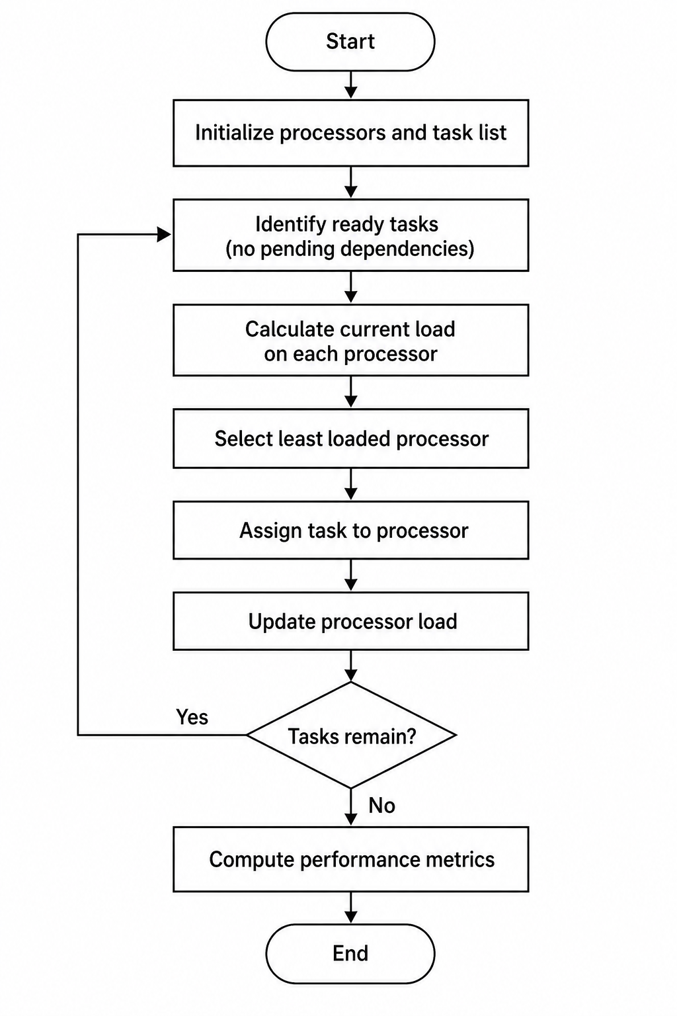
Load-Aware Algorithm: Core Logic
Instead of assigning tasks blindly, LoadAware selects the processor with the least current workload.
→ Dynamic decision based on real-time processor state
→ Minimizes idle time and imbalance
Algorithm Steps
Identify Ready Tasks: Select tasks with no pending dependencies
Calculate Current Load: Sum execution times of assigned tasks for each processor
Find Minimum Load: Identify processor with least total workload
Assign Task: Allocate task to selected processor
Update Load: Add task execution time to processor's load
Repeat: Continue until all tasks are scheduled
Why it works:
Minimizes idle time
Balances workload dynamically
Improves overall efficiency.
Limitations:
Greedy approach
Does not consider future tasksschedules.

Slide 7
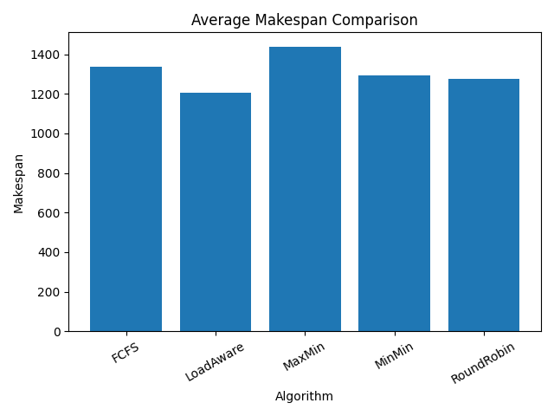
Results — Makespan
Average time units to complete all tasks · lower is better
Best
2nd Best
Worst
LoadAware
MaxMin
RoundRobin
1,221 units
1,258 units
1,426 units
Observations
LoadAware achieves the lowest average makespan, indicating efficient workload distribution across processors
RoundRobin performs closely, showing stable and fair task allocation
MaxMin results in the highest makespan, due to prioritizing long tasks and creating execution bottlenecks
Why this happens?
LoadAware minimizes idle time by balancing processor loads dynamically
MaxMin delays smaller tasks, causing underutilization of processors
RoundRobin ensures fairness but does not optimize based on execution time
LoadAware consistently achieves the lowest makespan by balancing workload, while MaxMin underperforms due to task prioritization imbalance. RoundRobin provides stable performance but lacks optimization.
Notes:
‹#›

Slide 8
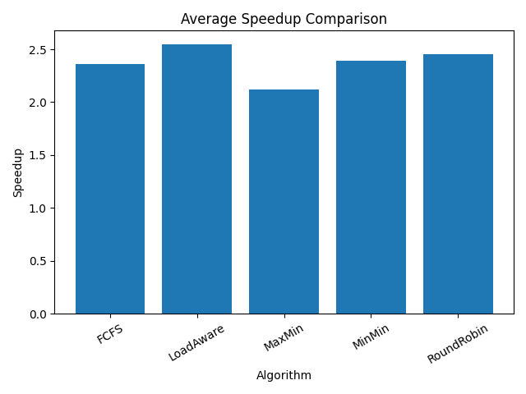
Results — Speedup
Parallel speedup vs sequential single-processor execution · higher is better
Observations
LoadAware achieves the highest speedup (~2.48×), indicating efficient parallel execution
RoundRobin performs closely (~2.4×), showing stable task distribution
MaxMin has the lowest speedup (~2.08×) due to inefficient scheduling
Why this happens?
Speedup depends on how effectively processors are utilized in parallel
LoadAware reduces idle time → more parallel work executed simultaneously
MaxMin creates bottlenecks → limits concurrent execution
RoundRobin ensures fairness but does not fully optimize execution time
LoadAware achieves the highest speedup due to balanced workload distribution. However, gains diminish as processors increase due to dependency constraints, consistent with Amdahl’s Law.
Notes:
‹#›

Slide 9
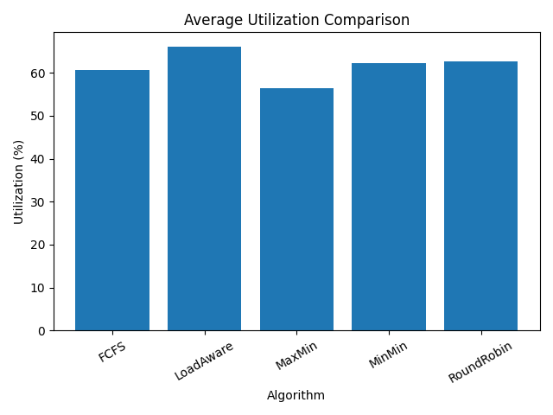
Results — CPU Utilization (Efficiency)
Fraction of time processors are doing useful work · higher is better
Observations
LoadAware achieves the highest utilization (~66%), indicating better processor usage
RoundRobin and MinMin show moderate utilization (~62–64%)
MaxMin has the lowest utilization (~56%), due to uneven workload distribution
Overall utilization remains well below 100%, showing limitations in parallel execution
Why this happens?
Task dependencies prevent all processors from working simultaneously
Some processors remain idle while waiting for prerequisite tasks
LoadAware minimizes idle time through balanced scheduling
MaxMin creates imbalance → some processors overloaded, others idle
Utilization decreases as dependency constraints increase, leading to processor idle time. LoadAware maintains the highest utilization by balancing workload, while MaxMin performs worst due to imbalance.
Notes:
‹#›

Slide 10
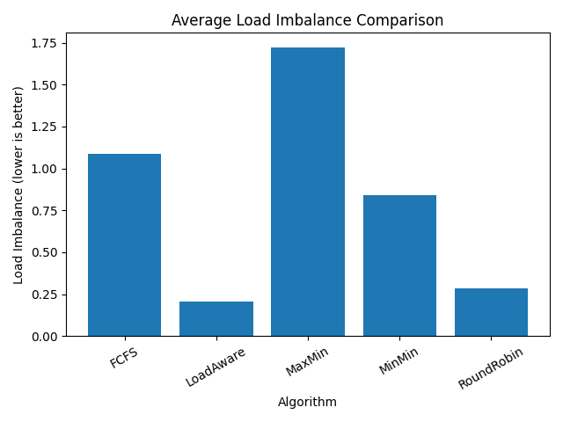
Results — Load Imbalance
Observations
LoadAware achieves the lowest load imbalance (~0.23–0.29), indicating near-uniform workload distribution
RoundRobin also performs well (~0.28), due to cyclic task assignment
MinMin and FCFS show moderate imbalance, as they do not consider processor load explicitly
MaxMin has the highest imbalance (~1.7+), indicating poor distribution of tasks
Work distribution across processors · lower = more balanced
Why this happens?
LoadAware assigns tasks based on current processor load, ensuring balanced execution
RoundRobin distributes tasks evenly but ignores execution time differences
MaxMin prioritizes large tasks → some processors overloaded while others remain idle
FCFS and MinMin lack load awareness → uneven workload distribution
LoadAware achieves near-perfect load balance, ensuring efficient processor utilization. In contrast, MaxMin creates significant imbalance by prioritizing long tasks, leading to idle processors and reduced performance.
Notes:
‹#›

Slide 11
Master Comparison Table
Averaged across all 9 configurations (3 task counts × 3 processor counts)
Algorithm | Avg Makespan ↓ | Avg Speedup ↑ | Avg Utilization ↑ | Load Imbalance ↓ | Throughput ↑ | Overall Rank
FCFS | 1,503.1 | 2.32x | 60.78% | 1.09 | 0.0665 t/u | 3rd
RoundRobin | 1,427.9 | 2.45× | 61.88% | 0.34 | 0.0700 t/u | 2nd
MinMin | 1,520.9 | 2.20× | 59.64% | 1.07 | 0.0657 t/u | 4th
MaxMin | 1,725.9 | 2.08× | 55.36% | 2.23 | 0.0579 t/u | 5th
LoadAware | 1,420.9 | 2.48× | 61.81% | 0.292 | 0.0704 t/u | 1st
* Throughput = avg task count / avg makespan (tasks per time unit)
LoadAware wins 5 of 5 metrics. RoundRobin is the second best after LoadAware. MaxMin is worst in every single metric.
Notes:
‹#›

Slide 12
Key Findings
Data-backed conclusions from experiments
#01
#02
LoadAware = Best Overall
LoadAware = Best Utilization
Achieves best performance across all metrics: ~1,420 makespan, ~2.48× speedup, ~61–66% utilization, and lowest imbalance (~0.29). Dynamic load-based scheduling minimizes idle time.
Highest utilization achieved due to balanced processor workload. Ensures minimal idle time compared to other algorithms.
#03
#04
MaxMin = Worst Performer
Dependencies Limit Parallelism
High imbalance (~2.2+) and lowest utilization (~55%) due to long-task prioritization causing processor bottlenecks.
Task dependencies restrict simultaneous execution, leading to processor idle time and reduced efficiency.
#05
#06
Diminishing Returns with More Processors
Synchronization Overhead Exists
Speedup gains reduce as processors increase (Amdahl’s Law), due to sequential components and scheduling overhead.
Parallel execution requires coordination, which can introduce minor overhead and limit scalability.
Notes:
‹#›

Slide 13
Conclusions
What We Proved
Limitations
Future Work
LoadAware achieves the best overall performance, with lowest makespan, highest speedup, highest utilization, and minimal load imbalance
Synthetic task generation may not reflect real-world workload characteristics
Implement work-stealing scheduling for dynamic load balancing across processors
RoundRobin performs consistently well, but lacks load-awareness optimization
Centralized scheduling approach introduces coordination overhead and limits scalability
Extend to heterogeneous systems with speed-aware task allocation
MaxMin performs worst across all metrics, due to long-task prioritization causing severe imbalance
Homogeneous processor assumption (equal speed and capability) simplifies real-world complexity
Evaluate using real-world DAG benchmarks (e.g., PARSEC, SPLASH-2)
Increasing processors improves speedup, but gains diminish due to inherent sequential components (Amdahl’s Law)
No task preemption, so long-running tasks cannot be interrupted or rescheduled
Apply machine learning models to predict optimal scheduling strategy per workload
Task dependencies limit parallelism, leading to processor idle time and reduced utilization
Static batch model — does not support dynamic task arrivals or real-time scheduling
Develop distributed scheduling (MPI + OpenMP hybrid) for large-scale systems
Parallel Task Scheduler · C++ & OpenMP · Thapar University
Notes:
‹#›

